Slide 1
Georgia Milestones Assessment System
Information for Parents
Notes:
Welcome to Fulton County Schools GMAS Parent Information Session

Slide 2
Goals for Today
Provide an overview of the assessment design and scoring for the Georgia Milestones Assessment System (GMAS) End of Grade (EOG).
Provide access to resources to assist in understanding and accessing GMAS tools.

Slide 3
Purpose of the Georgia Milestones
Provide information on how well students are mastering state adopted content standards
Provide parents with information about their child’s learning and progress
Provide students with information about their own learning readiness
Provide information that will assist in improving school and program effectiveness

Slide 4
Assessment Performance and Scoring
Notes:
In this section, we will provide the performance and scoring of the assessment.

Slide 5
Georgia Milestones Achievement Levels
Notes:
The Georgia Milestones assessment has 4 performance levels. Beginning, Developing, Proficient, and Distinguished. One thing to note, the performance descriptors detail students’ knowledge and skills in relationship to the progression of Georgia Standards of Excellence content. They will also describe whether students need support in the next grade level.

Slide 6
Achievement Level Descriptors
Georgia Milestones Achievement Level Descriptors for Parents
​Understanding the Georgia Milestones Achievement Levels​​​
Achievement Level Descriptors
Notes:
Achievement Level Descriptors can help parents by giving context and meaning to scale scores by describing the knowledge and skills students must demonstrate to achieve each level. ALDs are descriptions of the knowledge and skills expected at each of the four achievement levels and were developed for each grade level and content area. Achievement Level Descriptors are available to summarize the concepts and skills for each grade level. Content level

Slide 7
GMAS Assessment Dates
ELA Math
Part I - Wednesday, May 3rd Part I – Tuesday, May 9th
Part II - Thursday, May 4th Part II – Wednesday, May 10th
Part III - Friday, May 5th
5th Grade Only: Science – Thursday, May 11th

Slide 8
Assessment Design and Item Types
Notes:
In this section we will talk about the design and item types that compose the assessment.

Slide 9
Assessment Times
Notes:
One thing to note, for each content area there is a maximum time aloud. If your students have a 504 or IEP plan, they will get additional time added to the maximum time aloud. ELA will be given to 3rd – 8th grade students. Science will be given to 5th and 8th grade students Social Studies will only be administered at grade *.

Slide 10
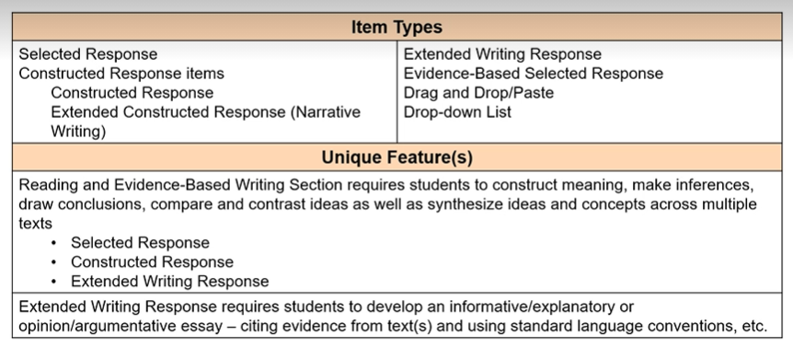
English Language Arts Item Types
Notes:
The test design for English Language Arts include; Georgia Milestones Interpretive scoring Guide Page 6

Slide 11
Math Item Types
Notes:
Read slide

Slide 12
www.desmos.com/testing
Notes:
Desmos Calculator will be assigned appropriately to corresponding math assessments.

Slide 13
Science and Social Studies
Notes:
In science and social studies all items are selected response.

Slide 14
Technology Enhanced (TE) Examples

Slide 15
Understanding Student Score Reports
Notes:
In this section we will unpack individual score reports. Due to budget cuts the GA Department of Education will not provide individual school reports to school districts this year.

Slide 16
Sample Student Report
Scale Score: This area of the report shows a student’s scale score and the range of scale scores for the achievement level for all four content areas.
Notes:
Each content area that your student tested in will have a detailed score report. The report is used to help educators and parents make decisions about the next step in the student’s individual learning cycle.

Slide 17
Sample Score Report
Domain Category and Performance: Standards for each grade level and content area have been grouped into domains, or clusters of standards with related content. Reporting information at the domain level helps identify relative strengths and weaknesses of the student with respect to course content. Domain performance is reported by domain mastery categories: Remediate Learning, Monitor Learning, or Accelerate Learning.

Slide 18
Sample Score Report
Comparison of the student’s performance to a national sample of students: A concordance table was built between the Georgia Milestones and TerraNova assessments that allows the student to receive a national percentile range.

Slide 19
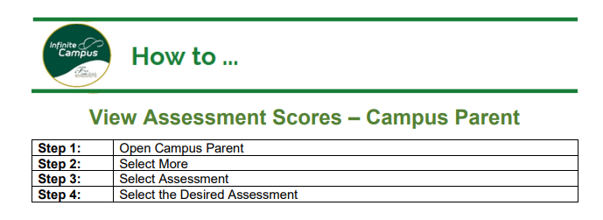
Campus Parent
Individual Student Assessment Performance
Access GMAS student score report through Infinite campus - link below
https://www.fultonschools.org/infinitecampus

Slide 20
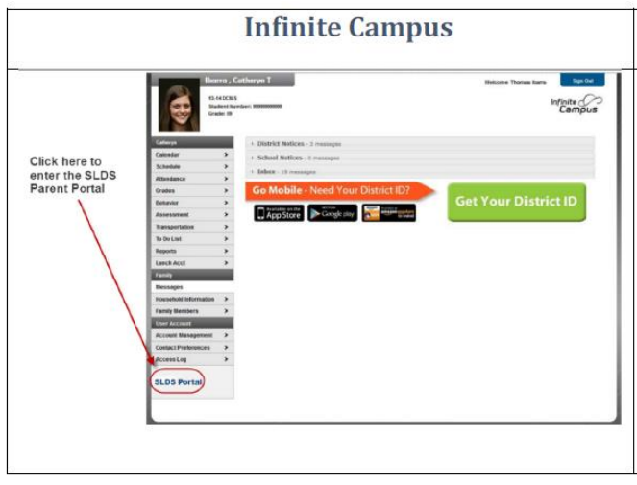
How to Access the Georgia SLDS Parent Portal
Parents can access the Georgia SLDS Parent Portal by following these steps:
1. Login to the District’s Student Information System Parent Portal.
2. Click the SLDS Portal button at the bottom of the list on the left side of the student’s page.

Slide 21
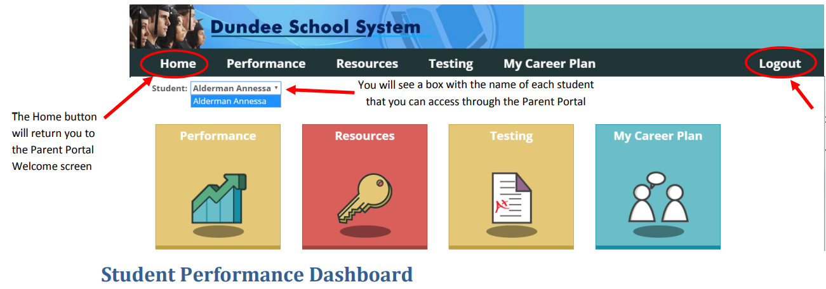
How to Access the Georgia SLDS Parent Portal
3. After clicking the SLDS Portal button, the Parent Portal Welcome Page will open. If you have access to more than one child in the district portal, you will see a dropdown box containing the name of each child.

Slide 22
Georgia Milestones Parent Resources
Georgia Milestones ​Parent Q & A Georgia Milestones Parent Q & A ​(Spanish)
​
2022-2023 Study/Resource Guides​ ​Grade 3 | Grade ​4 | Grade 5 | Grade 6 | Grade 7 | Grad​e 8​ | High School Physical Science (Grade 8 only)​​
American Literature and Composition​​ | Coordinate Algebra | Algebra I ​| Biology​ |
US History
​​

Slide 23
Thank You For Your Participation!

