Slide 1

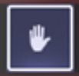
Welcome to 5th Grade Curriculum Night
We will begin promptly at 6:05 to allow time for parents to log in.
Please be mindful of keeping your mic muted during this presentation.
Please raise your virtual hand if you have a question. We will answer them periodically.
Once we begin, the meeting will be recorded. Due to Fulton County
requirements, all cameras must be turned off during a recording.

Slide 2

5th Grade Curriculum Night
August 31, 2023
6:00 – 7:00

Slide 3


Change of Transportation or early dismissal
Teachers cannot accept emails for transportation changes.
Parents must call the front desk to make a transportation change.
This is important because teachers are not at their computer while teaching and they may not see an email until after dismissal and if a teacher is absent, the substitute will not receive the email that was sent to the regular teacher.

Slide 4
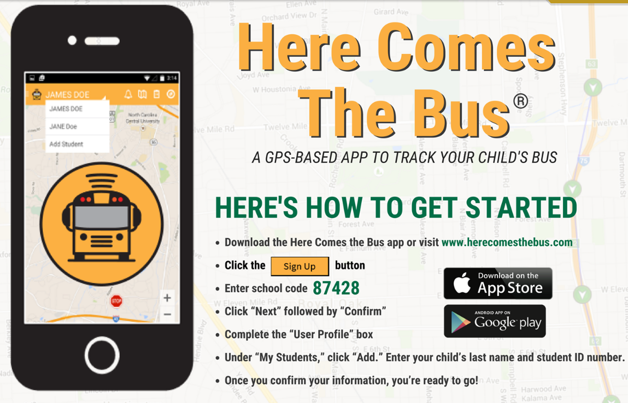
Transportation App

Slide 5

Absence Excusals
LWEattendance@fultonschools.org
Student’s first and last name
Date of Absence
Reason for the absence
(excusal reason must be provided)
Please send all excusal notes including medical excuses from providers to the
email address provided and CC homeroom teacher.

Slide 6

2023-2024 Code of Conduct: What You Should Know ?
18f.II Prohibited Use of Personal Communication Devices (PCD) During School Day
Possession of Personal Communication Devices (PCD) (e.g., cell phones, tablets, recording devices) by a student at school during school hours is a privilege that will be forfeited if a student fails to abide by the Student Code of Conduct.
-The use of PCDs (This includes SMART watches) during the school day is not allowed in grades Pre-K through 5.
20b.III Bus Interference while in Motion
Students shall not throw any item inside, around, or out of a school bus whether or not the bus is in motion. Students may be charged with a higher-level infraction if throwing items inside or out of a bus while in motion. If any item thrown or set in motion by a student makes contact with another individual or their property, then additional rule violations may apply.

Slide 7
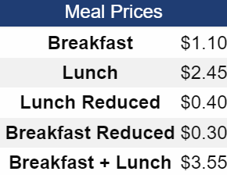
School Lunch
Lunch and breakfast are available for students to purchase:
https://www.fultonschools.org/lakewindwardes

Slide 8
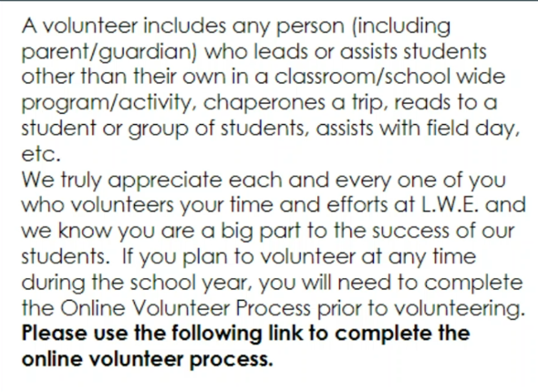
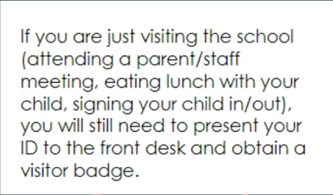
Volunteers
Visitors

Slide 9
Home to School Communication
Graded Papers will be sent home every 2 weeks
Take home folder/homework folder
  Return to school/Keep at home
5th grade website, you may access this from the Lake Windward Website Home Page
  Week at a Glance updated every Sunday evening

Slide 10
Parent/Teacher Communication
E-mail: Checked before or after school. Please allow 24 business hours for the teacher’s response.
  Thompsonma1@fultonschools.org
  hodgedv@fultonschools.org
  keely@fultonschools.org
  porterfield@fultonschools.org
  johnstonne@fultonschools.org
  kumare@fultonschools.org
  Hardingh@fultonschools.org
  Morgank4@fultonschools.org

Slide 11
Infinite Campus
Infinite Campus is a way for you to check your child’s grades.
If you have any questions, please refer to the Fulton County website, or the Lake Windward Website.

Slide 12
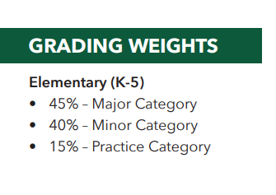
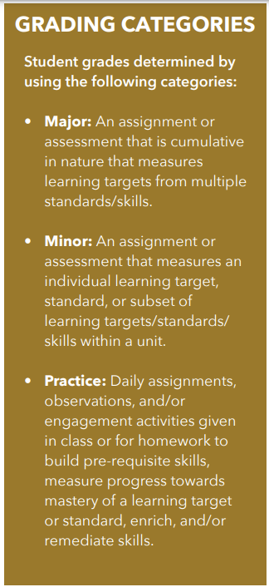
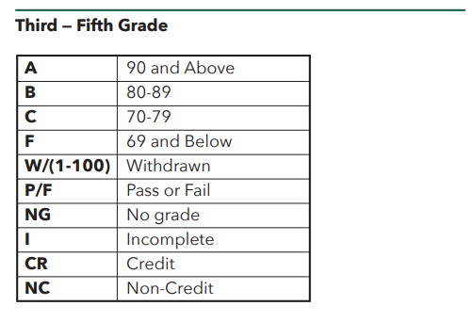

3rd – 5th
FC ES Infographic

Slide 13
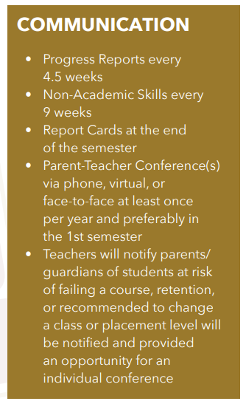
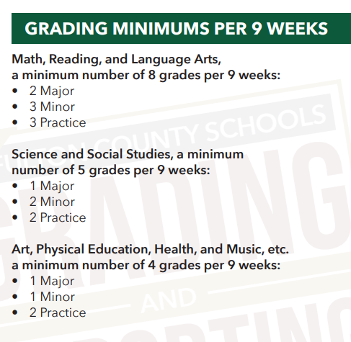
Kindergarten – 5th
This year, all reading and language arts grades will be reported under the language arts section.
FC ES Infographic
Parent Teacher Conferences will begin the first week in October. The official conference day is October 10, 2023. A sign-up form will be emailed to you.

Slide 14

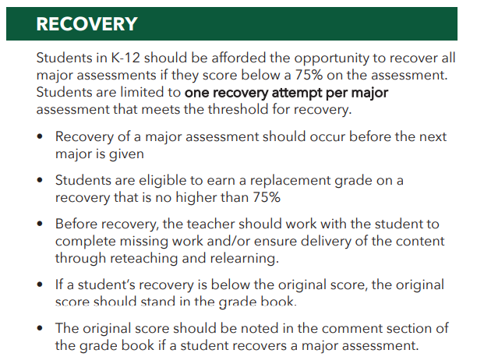
Kindergarten – 5th

Slide 15
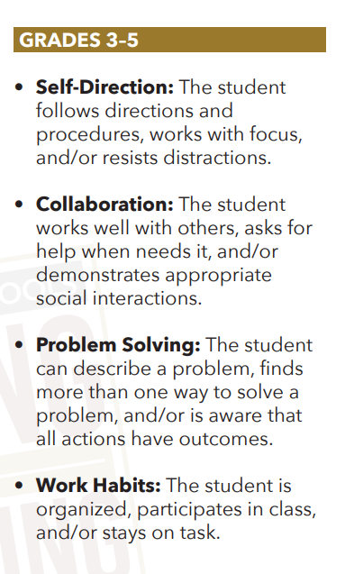
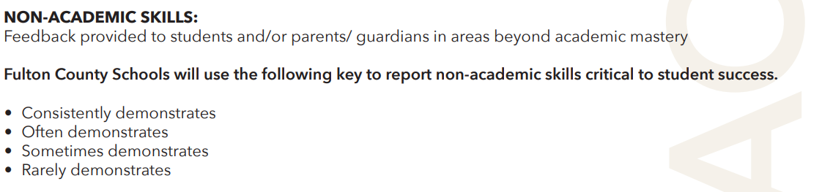
3rd – 5th Non-Academic Skills:
FC ES Infographic

Slide 16



Personal Belongings
Please be sure to write your child’s name on all coats/jackets, lunch boxes, book bag, pencil pouches and reusable water bottles.
If they misplace an item at school, having their name on their personal belongings will help us get the item back to the student.

Slide 17
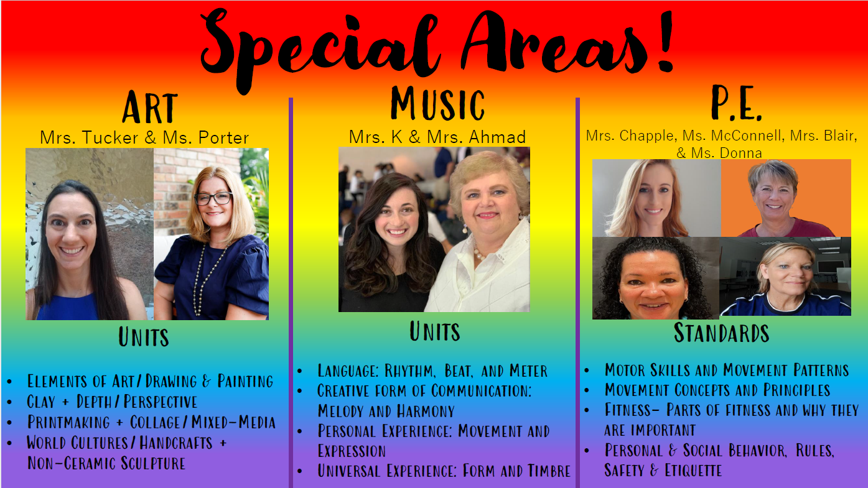
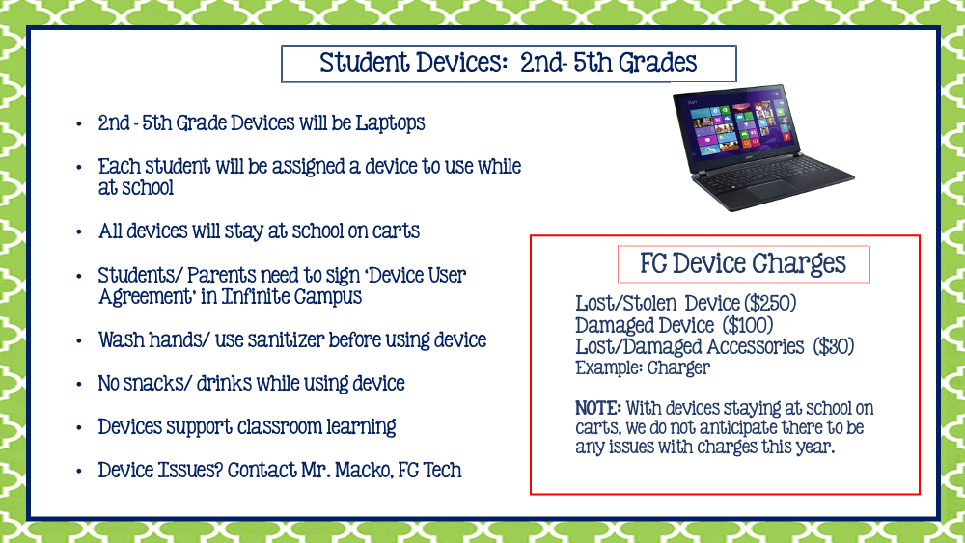

Slide 18

LWES PBIS
Multi-tiered, research-based system that matches student’s behavior needs
Reinforces Be Safe, Be Responsible, Be Respectful
Main focus is to recognize the positives
Consistent elements found in all areas of the building and all staff members use it
classroom, hallway, bus, cafeteria, recess, at-home

Slide 19
5th Grade Schedule
Time | Class
7:10 – 7:40 | Homeroom
7:40 – 8:15 | Announcements/Smart Time/SEL
8:20 – 9:05 | Specials
9:05 – 11:05 | AM Block
11:08 – 11:48 | Lunch
11:50 – 1:45 | PM Block
1:45 – 2:15 | Recess
2:20 | Dismissal

Slide 20
Social Emotional Learning (SEL)
Monday and Thursday's during SMART time
Self-management
Social Skills
Social Awareness
Self-care
Emotions

Slide 21

SMART Time
(7:40 – 8:15)
**All students should be available during SMART time on Tuesday, Wednesday, and Friday for flexible small groups
Small Group Re-teaching
Interventions
Reading

Slide 23
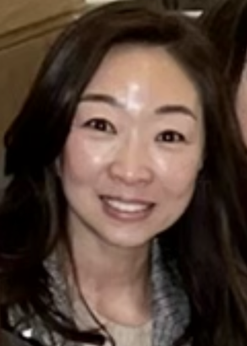
Priscilla Cho
Bilingual Community Liaison
Educate parents about school
Promote parental involvement in school and in child’s classroom.
There will be three workshops for parents this year:
  ESOL Parent Open House: September 19th at 4:30PM at LWE
  Infinite Campus: TBA
  Milestones: TBA
Hours: Tuesdays and Wednesdays 8:00-3:00, Thursdays 8:00-2:00
chop@fultonschools.org
(470) 254-7050 ext. 29590

Slide 24
Language Arts

Slide 25
English Language Arts Curriculum Overview
Reading: Providing evidence to support ideas
Writing: Narrative, Informational, and Argumentative
Speaking and Listening: Elaborate on ideas and formulate questions
Language: Varying sentences and using commas to elaborate and add voice

Slide 26

RELA Resources
Wonders (Kindergarten - 5th)
K – 5th
In Fulton County, Wonders is being used to teach the reading comprehension and writing Georgia Standards of Excellence.
“Through exploration of texts and daily development of their skills as readers, writers, speakers, and active listeners, students experience the power of literacy.”

Slide 27

RELA Resources
Vocabulary Surge (4th & 5th)
4th – 5th
Vocabulary Surge “ introduces the concept of word parts and guides students in examining the meaning and structure of high-utility word parts in order to build the most words in the English language.” This program includes manipulative experiences for students to help blend and create new words using provided root words and affixes.
Example Skills
most common affixes used with Anglo-Saxon words
46 common affixes used with Anglo-Saxon words and Latin Roots
Latin roots and affixes
Greek combining forms

Slide 28
How You Can Help Your Child
Create a space and time for students to read at home
Read with your child
  "Collect" and use new vocabulary
i-Ready – Close Read and Pathway
Make Connections and Build Background Knowledge
  Text to Self
  Text to Text
  Text to World

Slide 29


How You Can Help Your Child
Locate Great Titles: How old is the main character?
Website
Colby Sharpe’s Website
Look at his
“Awesome Books” Section
Check Titles at Commonsensemedia.org

Slide 30

Parents can access course materials on the Curriculum Hub.

Slide 31

Math

Slide 32
The Transition to Georgia’s
K-12 Mathematics Standards

Slide 33
Georgia’s New Math Standards
Beginning Fall 2023, the Georgia Department of Education retired the Georgia Standards of Excellence for Mathematics and will implement Georgia’s K-12 Mathematics Standards.
The new standards are designed to help learners achieve a balance among concepts, skills, and problem solving, while providing clear expectations for curriculum, instruction, assessment, and student work. The standards stress rigorous concept development and real-world applications while maintaining a strong emphasis on computational and procedural skills.
At all grades, the standards encourage students to reason mathematically, to evaluate mathematical ​arguments both formally and informally, to use the language of mathematics to communicate ideas and information precisely, and to make connections among mathematical topics and to other disciplines.​
Notes:
Math in context. Real World Connections

Slide 34
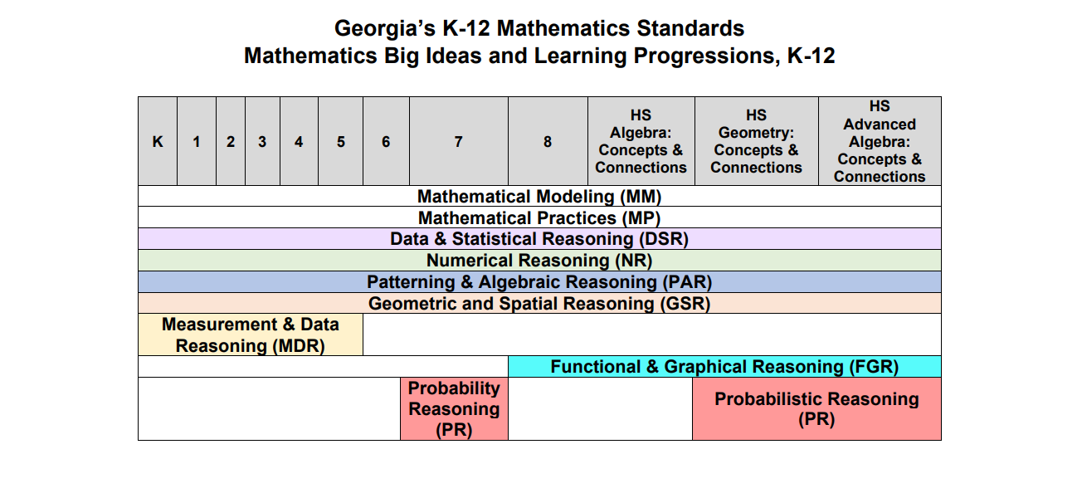
Big Ideas
Notes:
New Acronyms for Standards

Slide 35
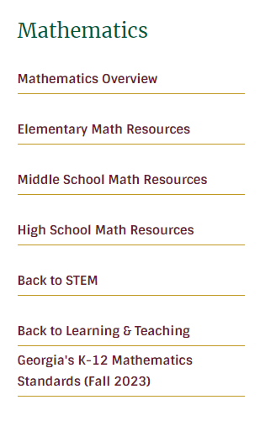

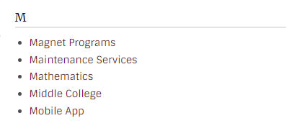
Where Can I Go For More Information?
Scroll down to M and choose Mathematics
From the FCS home page, select Departments at the top
Select Georgia’s K-12 Mathematics Standards (Fall 2023)

Slide 36
Math 5 Overview
Unit 1: Investigating Volume of Solid Figures
Unit 2: Place Value using Measurement and Data Reasoning
Unit 3: Multiplication and Division of Whole Numbers
Unit 4: Building Fraction Understanding
Unit 5: Making Sense of Fraction Multiplication and Division
Unit 6: Extending Place Value and Working with Decimals to Solve Problems.
Unit 7: Exploring Geometry and the Coordinate Plane
Unit 8: Culminating Unit (Milestones Review)
Notes:
New Order of Mathematical Units

Slide 37
Additional Skills for Grade 5 Enhanced
FCS Enhanced Mathematics: A Fulton County Board initiative that provides all students with the
opportunity to take algebra in grade 8.8.
Solve one-step equations and inequalities involving variables when values for the variables are given. Determine whether an equation and inequality involving a variable is true or false for a given value of the variable.
Explain the concept of a ratio, represent ratios, and use ratio language to describe a relationship between two quantities.
Determine greatest common factors and least common multiples using a variety of strategies to make sense of applicable problems.
Explore area as a measurable attribute of triangles, quadrilaterals, and other polygons conceptually by composing or decomposing into rectangles, triangles, and other shapes. Find the area of these geometric figures to solve problems.
Multiple and divide any combination of whole numbers, fractions, and mixed numbers using a student-selected strategy. Interpret products and quotients of fractions and solve word problems.

Slide 38
How You Can Help Your Child
Have your child teach you the math concepts they are learning
Practice multiplication and division facts regularly with your child (if applicable)
Find real-world math applications
iready – Own Path

Slide 39

5th Grade Social Studies

Slide 40
Social Studies- 3-week units
Content
Unit 1- Turn of the Century
Unit 2- World War I
Unit 3- The Great Depression
Unit 4- World War II
Unit 5- The Cold War
Unit 6- America Since 1975
Unit 7- Economics & Government
Thinking Strategies
Compare/Contrast
Sequencing
  Chronological Order
Cause/Effect
Problem/Solution
Pro/Con

Slide 41


5th Grade Science

Slide 42
Science 3-week units
Earth Science - constructive and destructive forces and their effects on the surface features of the earth
Life Science - how living things are sorted into groups, learned and inherited behaviors, parts of various types of cells, benefits and harmful microorganisms
Physical Science - physical and chemical changes, static and current electricity and the components of electric circuits, comparison of a bar magnet with an electromagnet

Slide 43
Homeroom parents and classroom support
There will be 2 room parents for each classroom.
The homeroom teacher will email room parents when items or help is needed.
Thank you for your support.

Slide 44
PTO Video

Slide 45
Thanks for coming!

